Slide 1
Speech to Text, Text to Speech

Slide 2
Challenges
Artificial or Robotic-Sounding Speech
Inaccurate Pronunciation
Lack of Emotion or Expression
Limited Language Support
Technical Limitations
Unnatural Pausing or Pacing
Background Noise or Statics

Slide 3
Building the best experiences
HD Voice Technology
Audio codecs
Microphone and Speaker quality
Noise cancellation
Acoustic Modelling
NLP
Real Time audio processing
Voice biometrics
End to End encryption
Different languages (Spanish)
Notes:
Leveraging HD (High Definition) voice for conversational AI phone calls is essential to ensure clear, natural, and effective communication with users. To achieve this, you can explore various aspects and technologies:
HD Voice Technology: Start by understanding the fundamental technology behind HD voice, which is an enhanced voice communication technology that provides better audio quality compared to traditional phone calls. HD voice utilizes wideband audio codecs to transmit a wider range of audio frequencies, resulting in clearer and more natural-sounding conversations.
Audio Codecs: Familiarize yourself with the various audio codecs used in HD voice, such as Opus, AMR-WB, and G.722. These codecs are optimized for voice quality and are essential for achieving high-quality audio in your AI phone calls.
Network Infrastructure: Ensure that your network infrastructure, including your telephony and VoIP systems, supports HD voice. This may involve working with network administrators and telecom providers to enable HD voice capabilities.
Microphone and Speaker Quality: Pay attention to the quality of the microphones and speakers used in your conversational AI devices or software. High-quality hardware can significantly contribute to better audio experiences.
Noise Cancellation: Implement advanced noise cancellation algorithms to remove background noise and ensure that only the user's voice is transmitted in high quality. This is crucial for noisy environments.
Echo Cancellation: Echo cancellation is important to eliminate echoes and feedback in the call, which can affect call quality.
Acoustic Modeling: Invest in advanced acoustic modeling techniques to better understand and process the user's speech. This includes using deep learning models to transcribe and analyze the audio data.
Natural Language Processing (NLP): Implement sophisticated NLP models that can understand and respond to spoken language more naturally. Combine HD voice with advanced NLP for a more human-like conversation.
Real-Time Audio Processing: Develop or use real-time audio processing tools that can enhance the audio quality on the fly, correcting for issues like jitter, latency, and packet loss.
Voice Biometrics: Integrate voice biometrics for user authentication and personalization. This can improve security and user experience.
End-to-End Encryption: Ensure that your AI phone calls are secure by implementing end-to-end encryption to protect user data and conversations.
Compliance and Regulations: Be aware of any legal and regulatory requirements, such as GDPR, HIPAA, or other data protection laws, that may apply to the storage and handling of audio data in AI phone calls.
Testing and Quality Assurance: Rigorous testing and quality assurance are essential to ensure that your HD voice technology works reliably and consistently across different devices and network conditions.
User Feedback and Iteration: Continuously gather user feedback to identify areas of improvement and iterate on your conversational AI system to enhance HD voice capabilities.
User Experience (UX) Design: Consider the overall user experience and interface design to make it intuitive and user-friendly.
https://telnyx.com/the-better-twilio-alternative

Slide 4
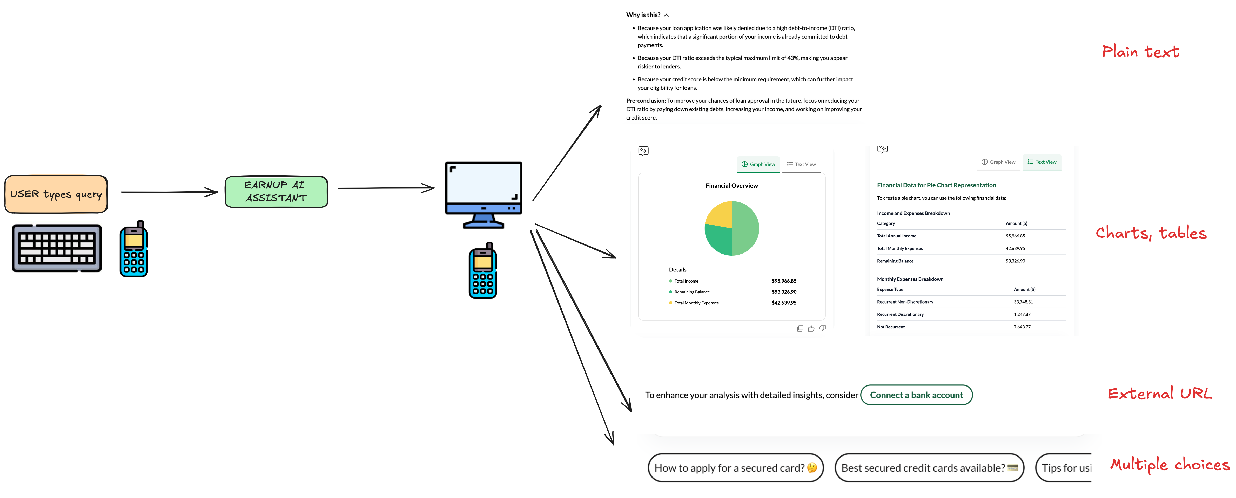
Current mode

Slide 5
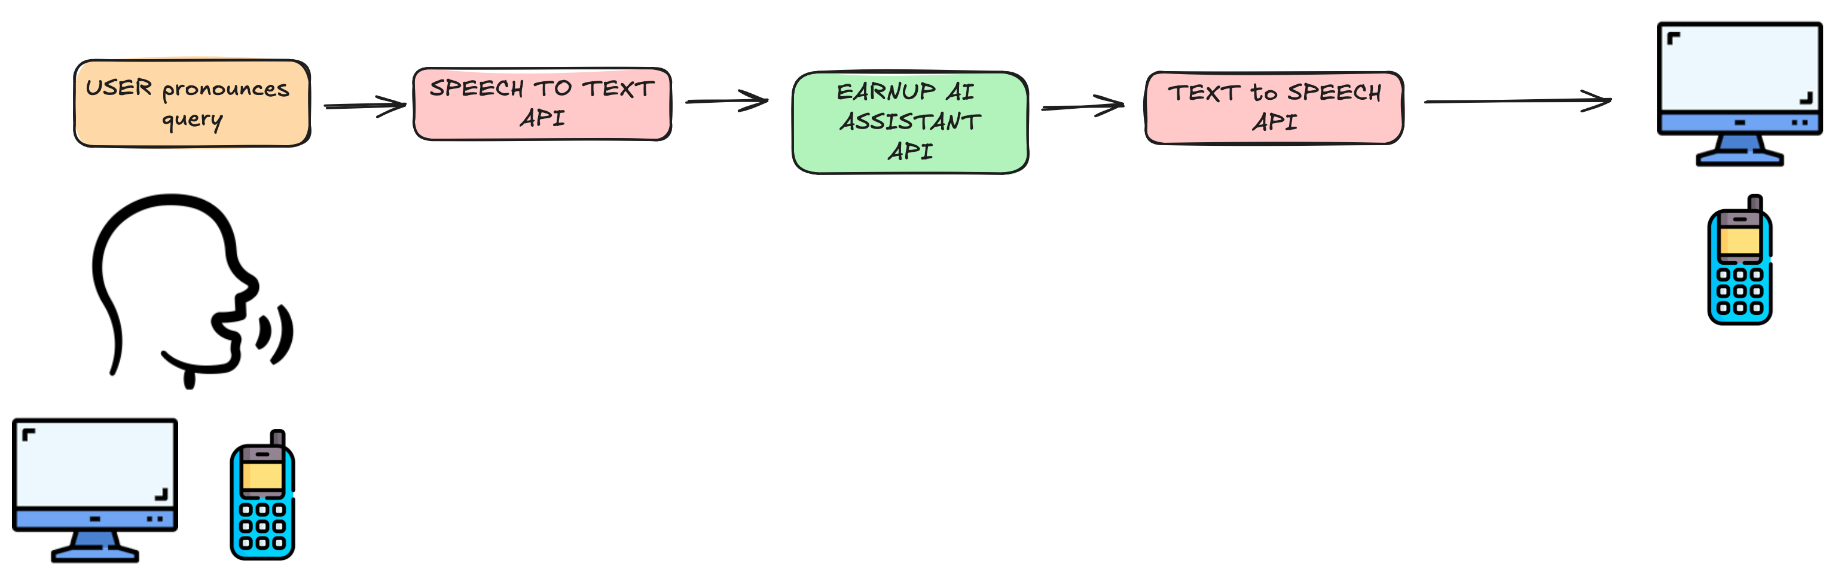
Introducing voice

Slide 6
Solutions
Deepgram
Assembly AI
Murf.ai
Google Cloud AI Speech to Text service
Krisp: https://krisp.ai/
AWS transcribe
Microsoft Bing Speech API
openAI Whisper

Slide 7
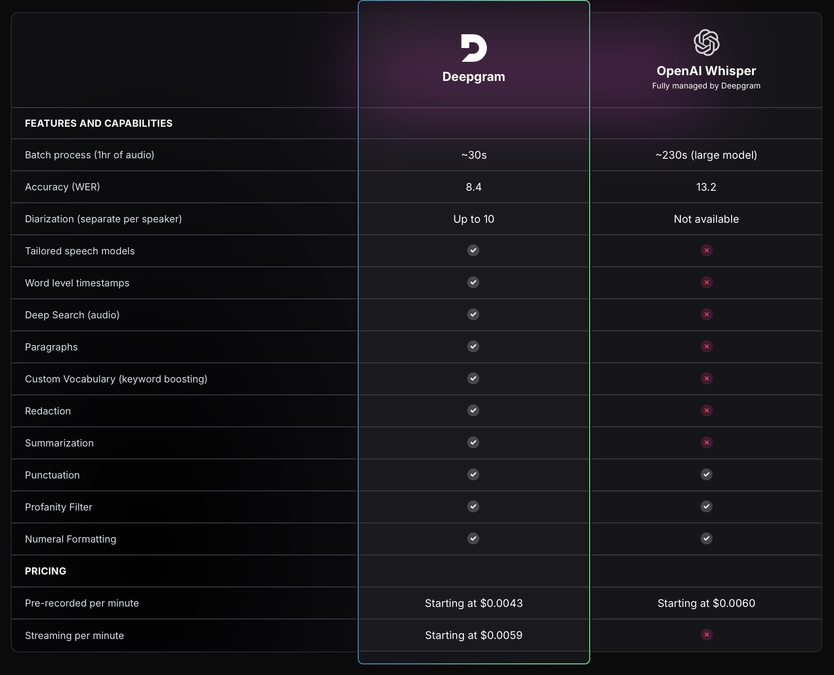
openAI vs. Deepgram
Model | Usage
Whisper | $0.006 / minute
TTS | $15.000 / 1M characters
TTS HD | $30.000 / 1M characters
openAI could be a good option for a one stop shop, for transcription (Sound to Text) and audio output (Text to Speech), in both english and Spanish
Already using openAI services
6 voices options.
No external API (Deepgram).
Need to check translation accuracy, latency.
Need to check data retention.

Slide 8
Solutions
OpenAI + Assembly.ai + Elevenlabs
3 different api’s
Assembly.ai:
STT, audio intelligence ; 92.5% accuracy ; 30ms latency ; diarization ; international language support
https://www.assemblyai.com
Eleven Labs:
TTS, voice generator, text sound effect(animal), voice cloning
OpenAI + Deepgram
2 different api’s
<300ms latency (including network latency)
Language detection, multilingual switch
Soc2, HIPPA, GDPR, CCPA, PCA compliants
Encryption of any sensitive or confidential information (including PHI and PCI data) in transit and at rest

Slide 9
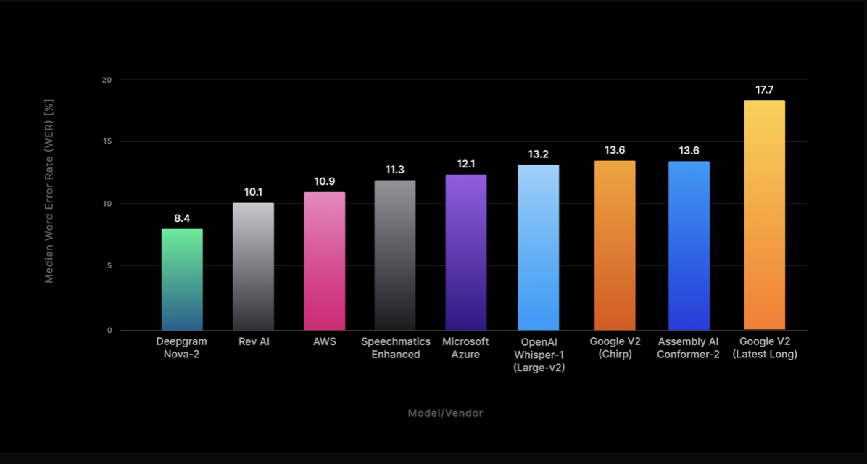
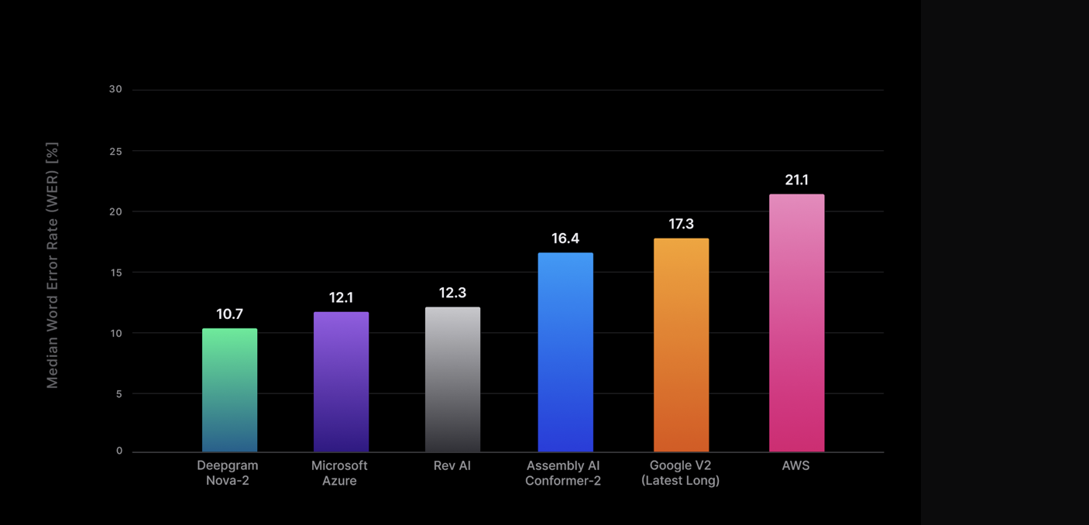
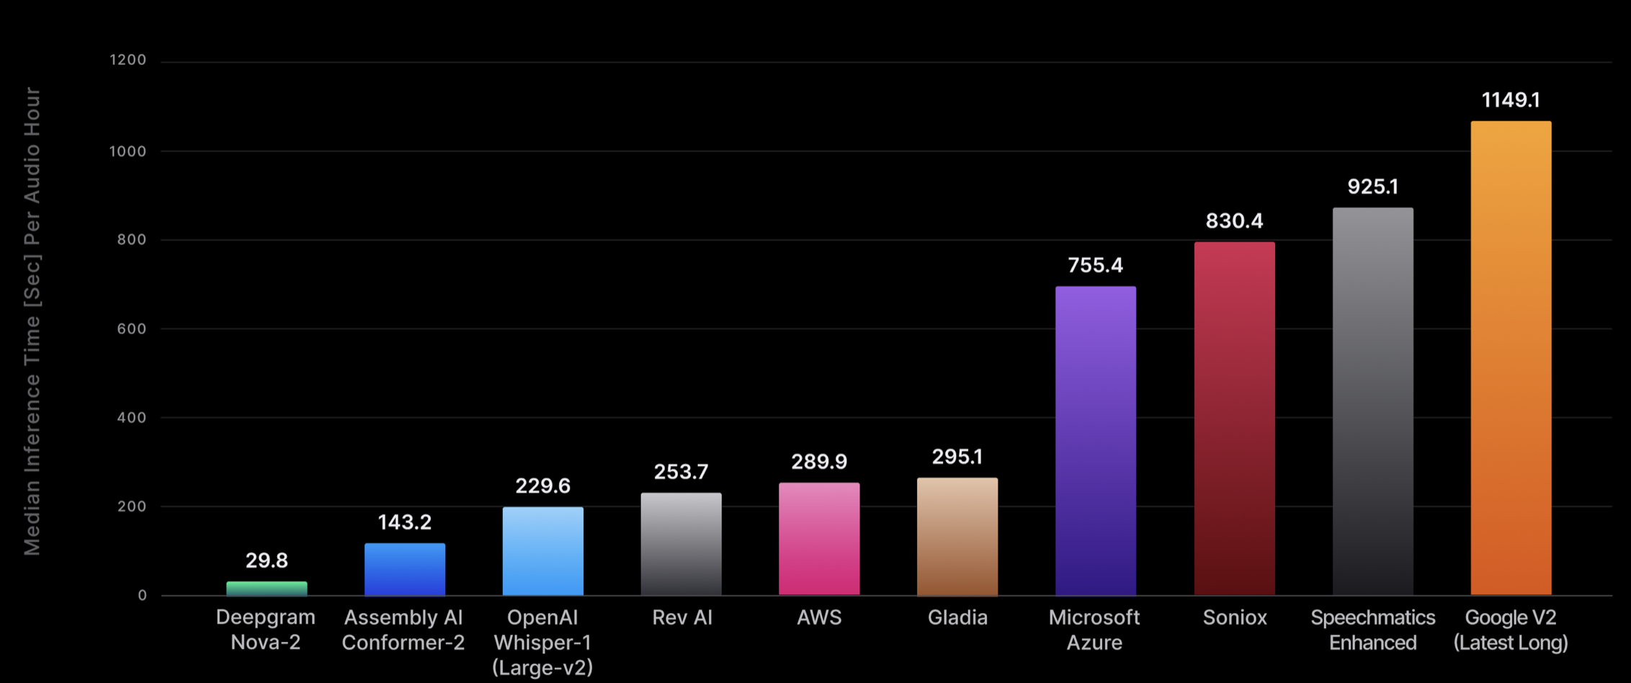
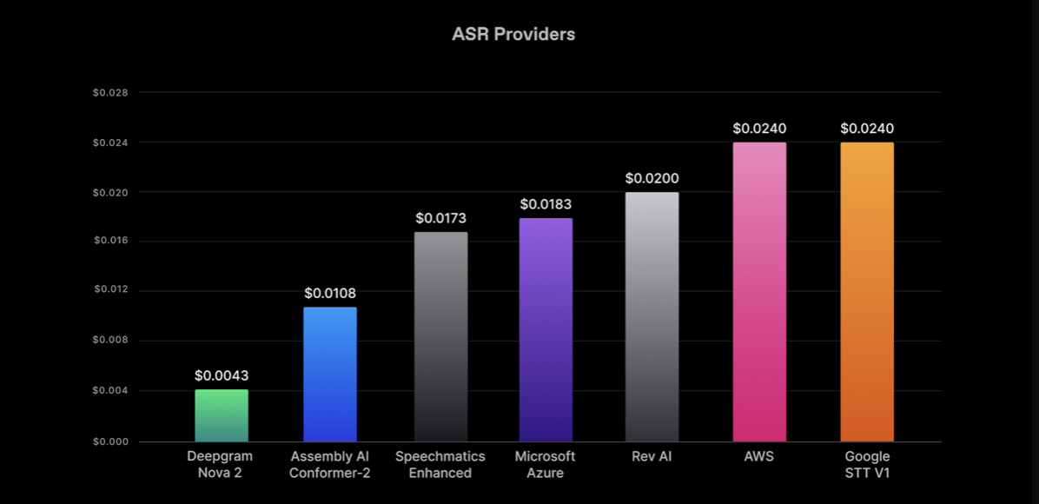
WER batch
WER real time
Time to transcribe 1h batch audio
Pricing

Slide 10
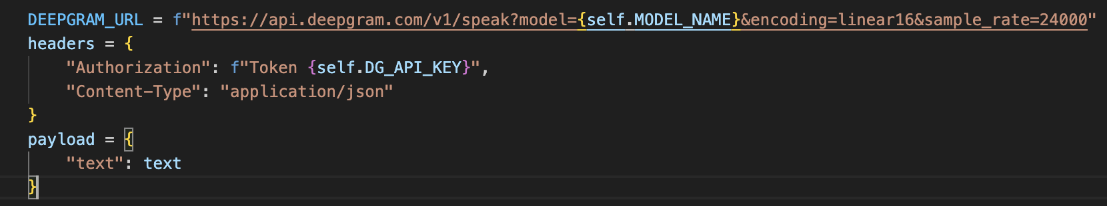
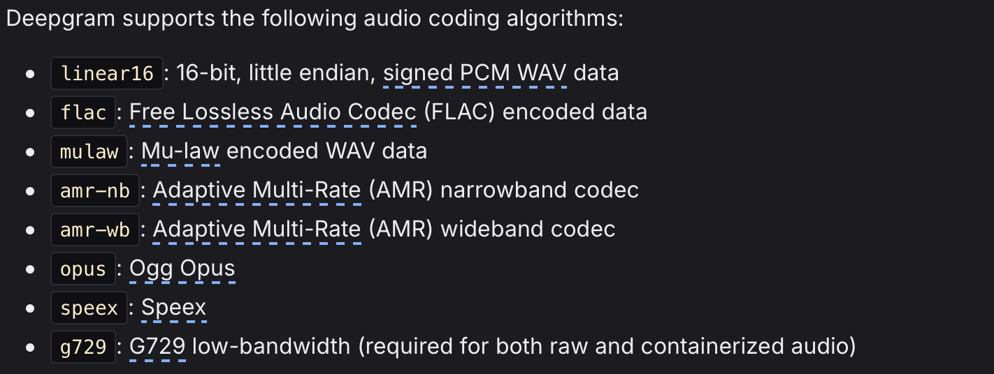
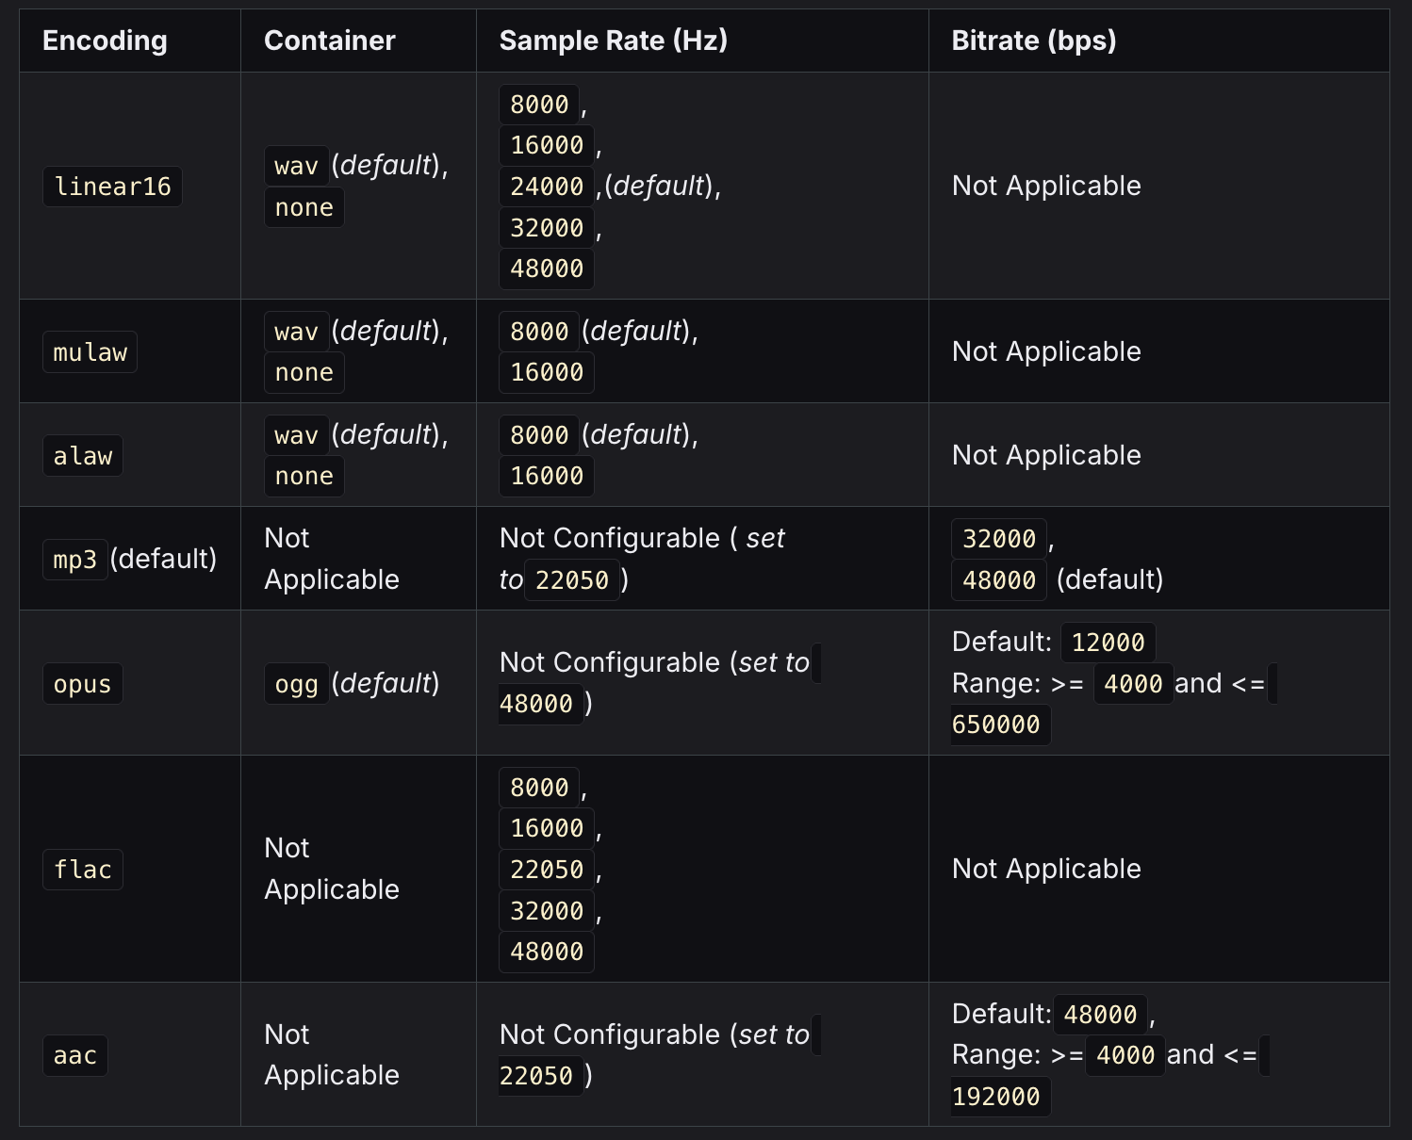
Encoding: expected encoding of submitted audio.
sample_rate: refers to the number of samples of audio carried per second, measured in Hertz (Hz).
Choosing the appropriate sample rate is crucial as it directly impacts the audio quality and file size of the output. Higher sample rates typically result in better audio quality but may increase the file size, while lower sample rates may reduce file size but can compromise audio fidelity.
Language: https://developers.deepgram.com/docs/models-languages-overview

Slide 11
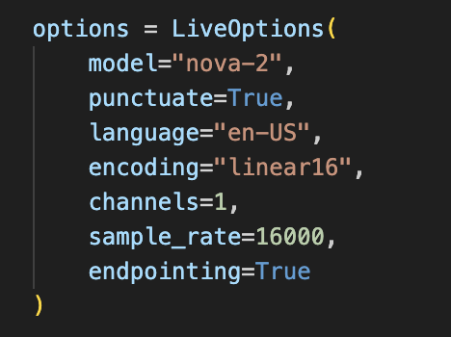
Options for transcription (nova-2 model)

Slide 12
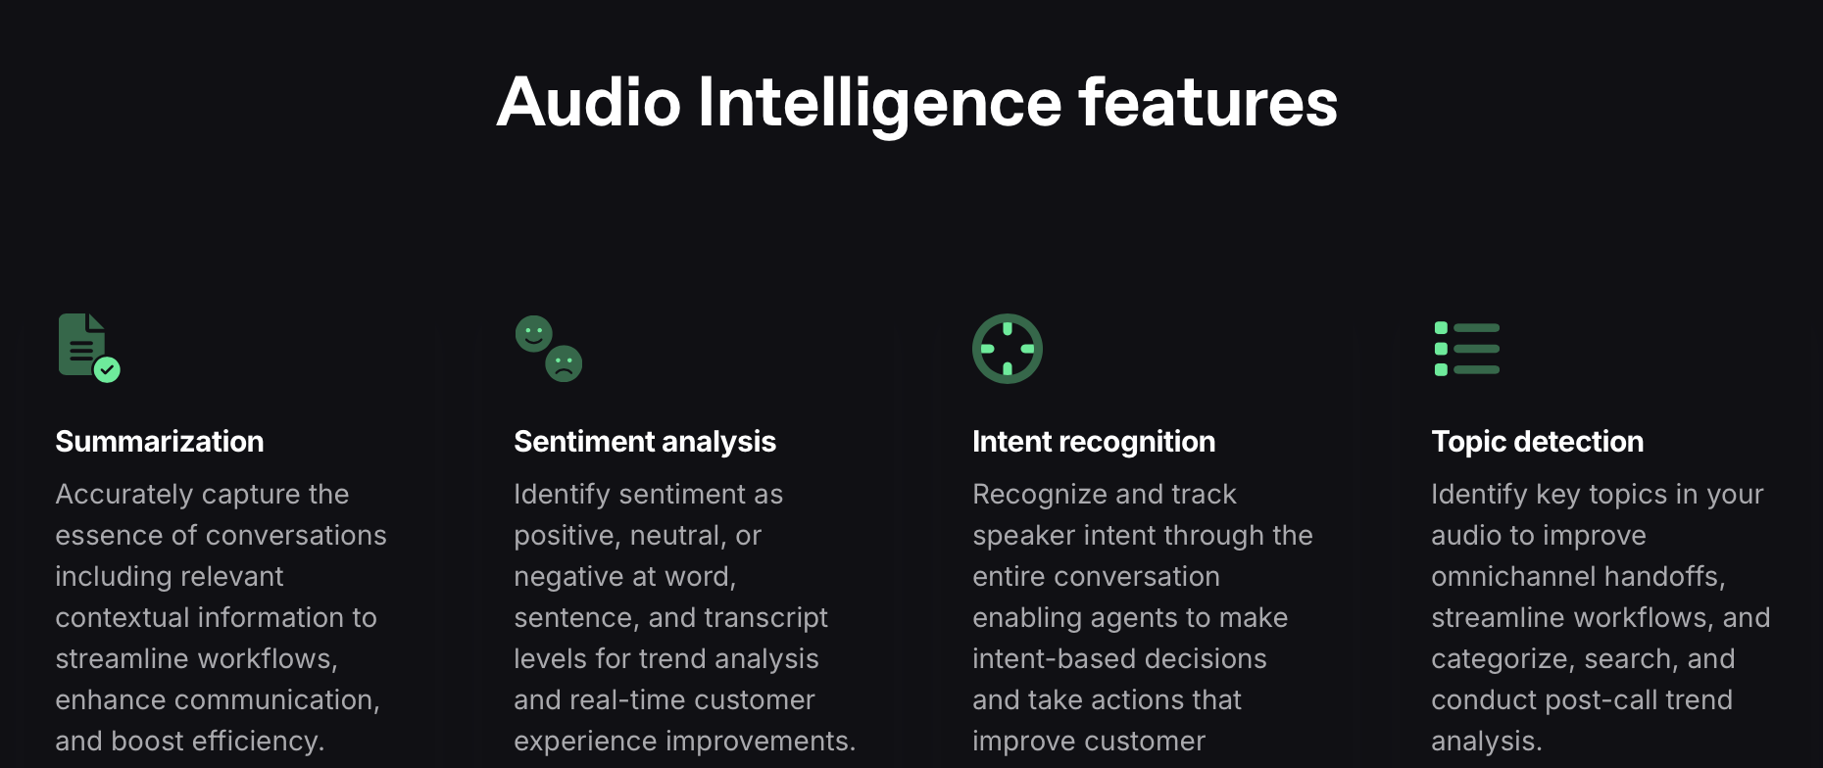
Deepgram intelligence features

Slide 13
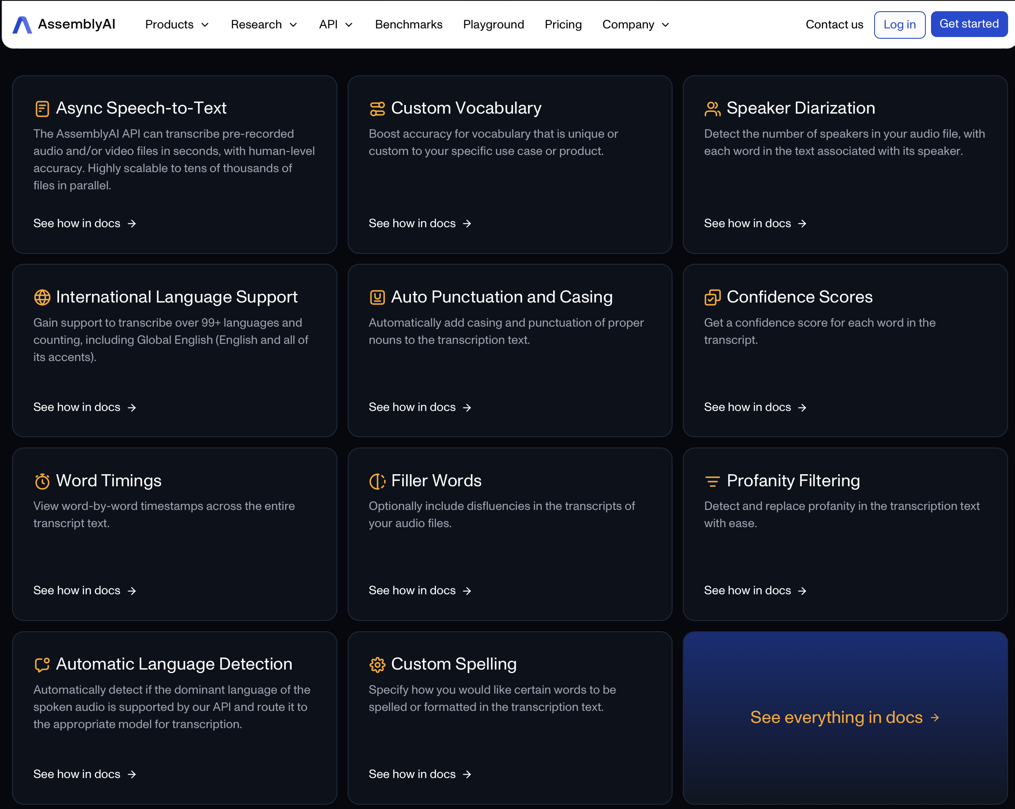
Assembly.ai features

Slide 14
EleveLabs free tier
10 minutes of ultra-high quality text to speech per month
Generate speech in 32 languages using thousands of unique voices
Translate content with automatic dubbing
Create custom, synthetic voices
Generate sound effects
API access
Standard models (Multilingual v2, Multilingual v1, English v1) are optimized for quality and accuracy, ideal for content creation. These models offer the best quality and stability but have higher latency.
Turbo models (Turbo v2, Turbo v2.5) are designed for low-latency applications like real-time conversational AI. They deliver great performance with faster processing speeds, though with a slight trade-off in accuracy and stability.
Security:
End to end encryption
AICPA, SOC2
GDPR compliant
No-retention mode

Slide 15
Deepgram

Slide 16
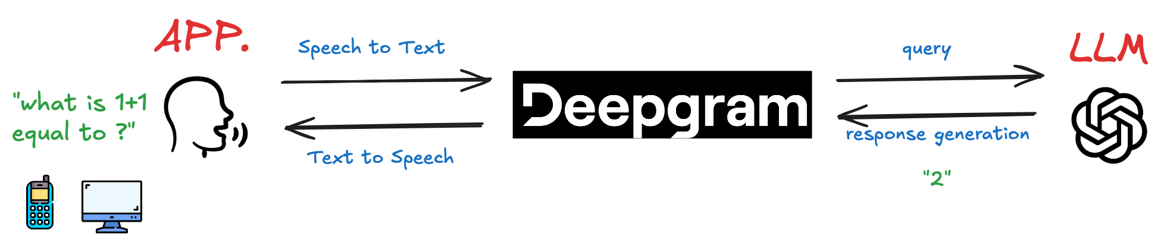
Voice Feature mode

Slide 17
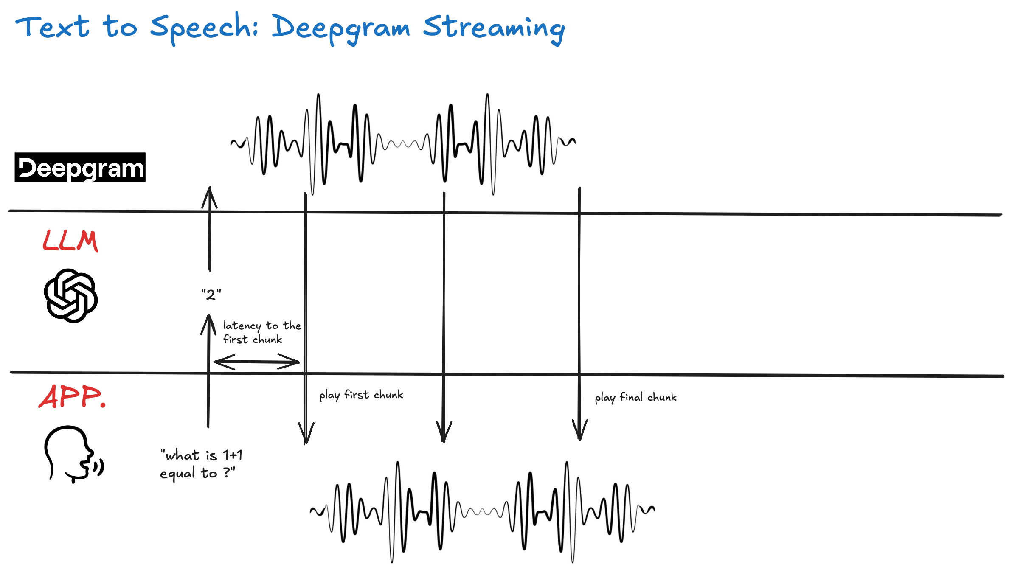
TTS: deepgram streaming

Slide 18
Considerations
Filler words to disguise latency
Interruptions
More difficult to handle
Software engineering improvement (interrupting / resuming an audio stream) rather than an AI improvement
Start the response before the user finishes:
Human starts forming their answer before the other person is done talking
Stream the speech to the LLM
Have the LLM predict the rest of the user speech
Form response based on expected user speech

